Slide 1
Pattern Recognition

Slide 2
Outline
Bayesian classifier

Slide 3
Classifiers, Discriminant Functions and Decision Surfaces
Remember the Bayesian classifier:

Slide 4
Classifiers, Discriminant Functions and Decision Surfaces
Remember the Bayesian classifier:
This is equivalent to:
decide x to class ω_{i}
if g_{i}(x) > g_{j}(x) ∀j ≠ i
where, g_{i}(x) =P(ω_{i}|x), i = 1,…, c

Slide 5
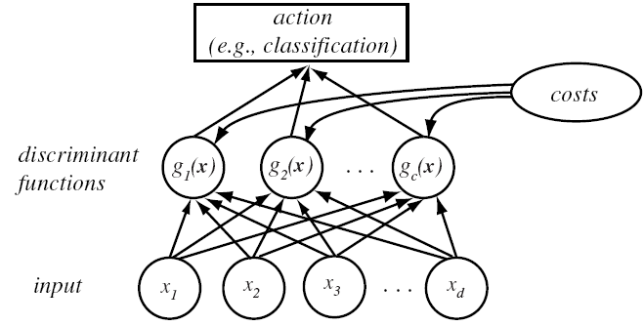
Classifiers, Discriminant Functions
and Decision Surfaces

Slide 6
Classifiers, Discriminant Functions
and Decision Surfaces
Based on minimum risk classification
  Let g_{i}(x) = - R(α_{i} | x)
(max. discriminant corresponds to min. risk!)

Slide 7
Classifiers, Discriminant Functions
and Decision Surfaces
For the minimum error rate, we take
  g_{i}(x) = P(ω_{i} | x)
(max. discrimination corresponds to max. posterior!)

Slide 8
Classifiers, Discriminant Functions
and Decision Surfaces
For the minimum error rate, we take
  g_{i}(x) = P(ω_{i} | x)
(max. discrimination corresponds to max. posterior!)
g_{i}(x) ≡ P(x | ω_{i}) P(ω_{i})
g_{i}(x) ≡ ln P(x | ω_{i}) + ln P(ω_{i})
(ln: natural logarithm!)

Slide 9
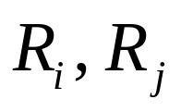
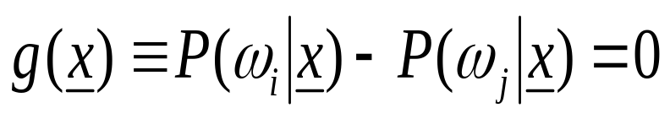
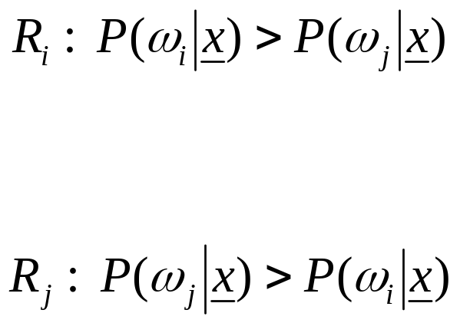

Decision Surface
If : two regions identifying classes ω_{i} and ω_{j}
+
-
decision surface

Slide 10
Decision Surface in Multi-categories
Feature space divided into c decision regions
if g_{i}(x) > g_{j}(x) ∀j ≠ i then x is in R_{i}
(R_{i} means assign x to ω_{i})

Slide 11
Decision Surface in Two-categories
The two-category case
  A classifier is a “dichotomizer” that has two discriminant functions g₁ and g₂
  Let g(x) ≡ g₁(x) – g₂(x)
  Decide ω₁ if g(x) > 0 ; Otherwise decide ω₂

Slide 12
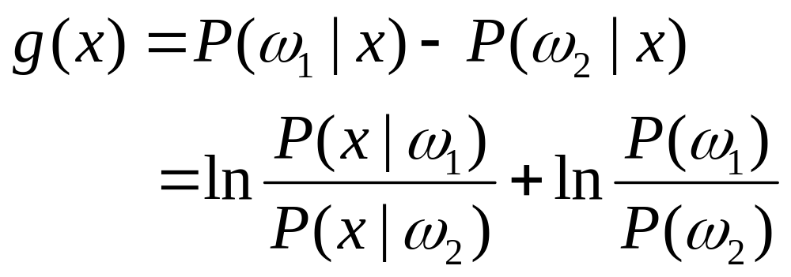
  The computation of g(x)

Slide 13
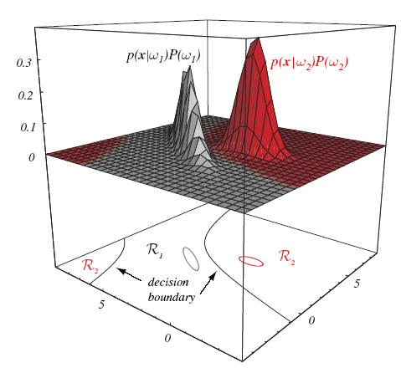

Slide 14
The Normal Density
model for class conditional probabilities

Slide 15
The Normal Density
Density which is analytically tractable
Continuous density
A lot of processes are asymptotically Gaussian
Handwritten characters, speech sounds are ideal or prototype corrupted by random process (central limit theorem)

Slide 16
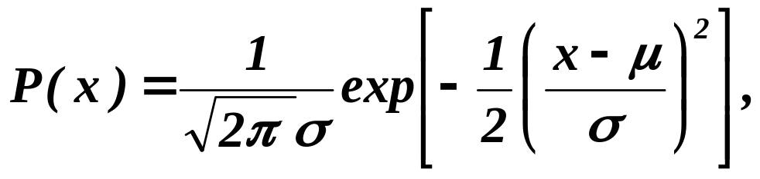
The Normal Density
Univariate density
Where:
μ = mean (or expected value) of x
σ² = expected squared deviation or variance

Slide 17
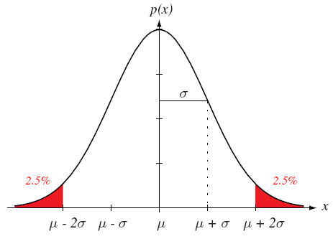

Slide 18
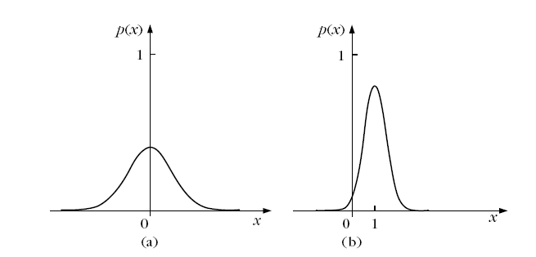

Slide 19
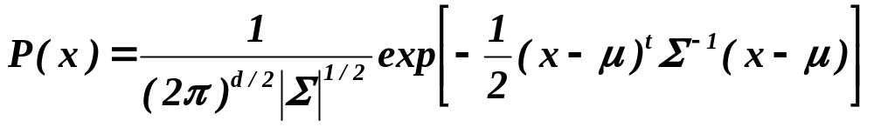
Multivariate density
  Multivariate normal density in d dimensions is:
where:
x = (x₁, x₂, …, x_{d})^{t} (t stands for the transpose vector form)
μ = (μ₁, μ₂, …, μ_{d})^{t} mean vector
Σ = d*d covariance matrix
|Σ| and Σ⁻¹ are determinant and inverse respectively

Slide 20

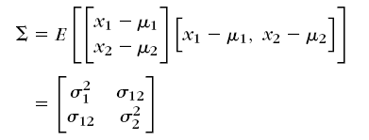
Multivariate density
  Multivariate normal density in d dimensions is:
where:

Slide 21


Slide 22

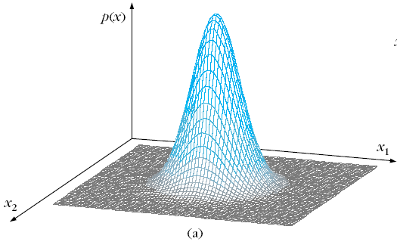
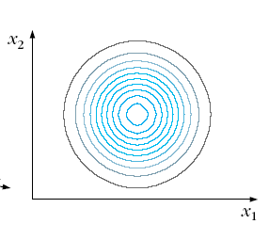
2D Gaussian Example - 1

Slide 23
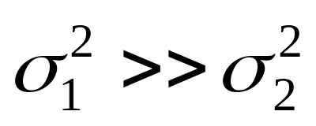
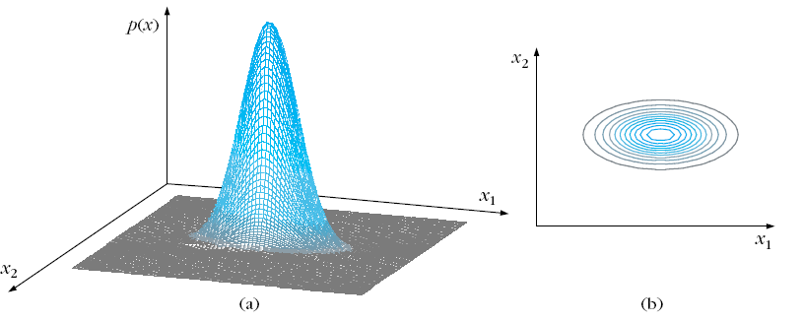
2D Gaussian Example - 2

Slide 24
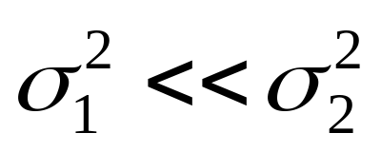
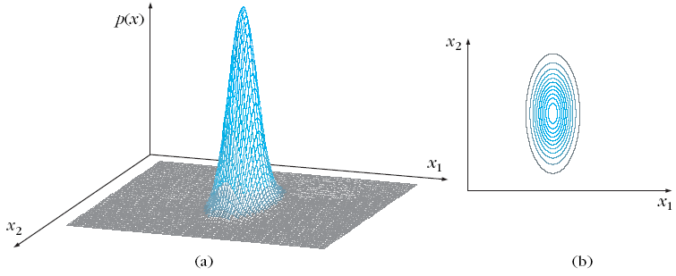
2D Gaussian Example - 3

